Slide 1
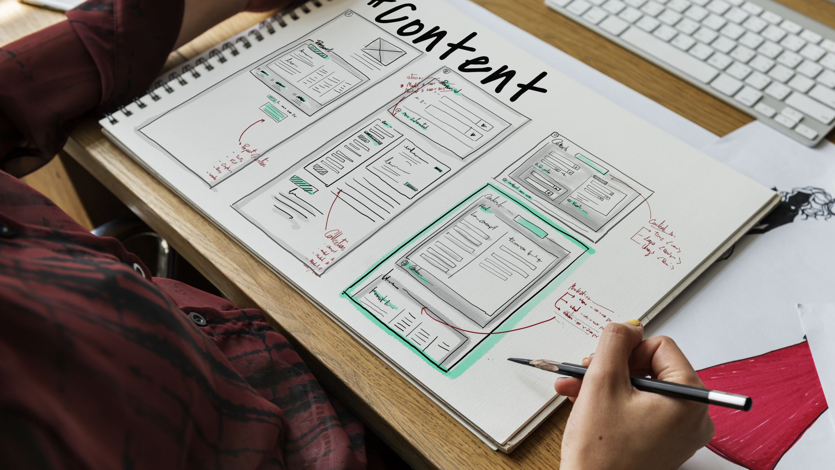
STORYBOARD
AMAP SHOPPING CENTRE

Slide 2
#homepage
AMAP Shopping Centre
Font size (Heading1, 60px), Bold, highlighted
Food
Shop
Leisure
Offers
Parking
Banks
Help
Menus with hover effect; orange padding and green hover effect. Font = Helvetica, Size= 22px
Grey whitespace
Notes:
The initial design of AMAP shopping centre has seven menus in total. The reduced number of menus originates from the idea that the users will be able to quickly glance their options and derive where their interests are. For instance, if customers are looking where they can find McDonald’s, they need not spend their time reading through all the menus and checking each of them.
As the names on the menus are directly related to its categories, even a novice users can confidently interact with the system without worrying about the consequences of erroneous clicks.
The homepage also excludes the presence of header and footer. The name of the shopping centre will serve as a title which will be highlighted, bold and 60px in size. This is done to give the menus more emphasis than anything else in the background.

Slide 3
Grey background with black texts of different font sizes: name (20px), floor (16px), location(18px)
#store list
header
List presented in 2 columns
AMAP Shopping Centre
Descriptions: name of store, floor, exact location. E.g. next to Nike.
Descriptions: name of store, floor, exact location. E.g. on the left of Vue.
store1
store3
Descriptions: name of store, floor, exact location. E.g. in front of Nike.
Descriptions: name of store, floor, exact location. E.g. in front of the elevator.
store2
store4
Logos or pictures of stores
Grey whitespace
Fixed footer that covers the entire width of the interface
Notes:
When users select “shop” or “food”, this is the page that will be displayed in the digital sign. There are not any sub-categories and the page will simply display all the stores in two columns. Listing them in two columns will consume less space.
Every store will have their logos on the left and description on the right. Below the description will be the location of the store in the venue. Unlike homepage, this page will have header and footer. The header will simply have the name of the shopping centre and will be clickable which will redirect users back to main page.
The footer will have black background that covers the entire width of the screen and will contain contact information and social media links. The text will have white font.
The whitespaces in the UI will have grey background to avoid extreme brightness.
All the other pages will have the same layout for consistency except “help” and “parking”. In case of “offers”, the stores that are giving discounts will be listed with the details of type of promotions like sales, clearance etc. on the description section.

Slide 4
#Help
header
AMAP Shopping Centre
Title here “How to navigate digital sign”
Text in bold, 20px
Tutorial Video
“You are here” map
Grey whitespace
footer that fits the entire width of the interface
Notes:
This slide shows how the “help” page will look like and what information it will contain. Instead of vertically sorting the contents into two sections, I decided to sort them horizontally which will make the page non-scrollable.
The benefit of this structure was to allow users to perform multiple task at the same time. When they are watching the tutorial video on how to navigate the digital sign, they can also see the map of the shopping centre which will tell them where they are at that moment and the direction they should head towards.
To successfully install this feature on the HCI solution, I needed the information where these digital signs will be placed in the building. The concept is to make the map 3D and have zoom in and out feature.
Grey whitespace, header and footer are still present on the design.

Slide 5
#parking
header
AMAP Shopping Centre
Grey whitespace
Short description of parking features
Photo of parking areas
Short description of parking features
Photo of parking areas
More parking features; location of parking spaces; highlighted in bold.
Parking rates in table format
footer that covers the entire width of the interface with contact information and social media links.
Notes:
This section of digital sign will have information on different type of parking services facilitated by AMAP shopping centre.
First thing to notice on this design is how the pictures will be placed on alternate sides with short sentences about the type of parking service. Below that will be a second section that will contain more parking features and information on where to access it. On the right side will be the rates of parking which is presented in the form of table.

